Slide 1
Data Minds
By :
Lakshya Saxena (23SCSE1180057) (Team Leader)
Shubham Kumar Bhagat (23SCSE1280054)
Rishabh Raj (23SCSE1012228)
Akash Gupta (23SCSE1011873)

Slide 2

Airbnb Data Analysis: Unlocking Insights for Hosts and Guests
This presentation explores data-driven strategies for optimizing Airbnb listings. We'll leverage data to understand market trends. This will improve decision-making for hosts. It will also enhance guest satisfaction.

Slide 3




Introduction to Airbnb Data Analysis
Airbnb's Industry Impact
Data Analysis Importance
Diverse Data Sources
Airbnb is valued over $150 billion. It reshaped hospitality.
We use official APIs, web scraping, and third-party datasets.
Data helps hosts and guests. It optimizes experiences.

Slide 4
Key Metrics for Airbnb Hosts
Occupancy Rate
Average Daily Rate (ADR)
Revenue Per Available Room (RevPAR)
Track listing performance. A healthy rate is 60-80%.
Optimize your pricing strategies. Maximize your earnings.
Combines occupancy and ADR. Improves total revenue.
Booking Lead Time
Length of Stay
Forecast demand. Adjust pricing accordingly.
Optimize for longer guest stays. This increases revenue.

Slide 5





Key Metrics for Airbnb Guests
Average Price
Review Scores
Response Time
Compare prices across listings. Find the best deals.
Evaluate listing quality. Check host reliability.
Gauge host responsiveness. Quick replies are good.
Location Score
Assess neighborhood quality. Check for safety.

Slide 6








Data Visualization: Geographic Trends
Popular Area Heatmaps
Price Variations
See popular areas by city. Also check neighborhoods.
Prices vary by location. Amenities also affect them.
Interactive Map Tools
Listing Density Maps
Use Tableau or Mapbox. Explore data visually.
View Airbnb listing density. Major cities are shown.

Slide 7
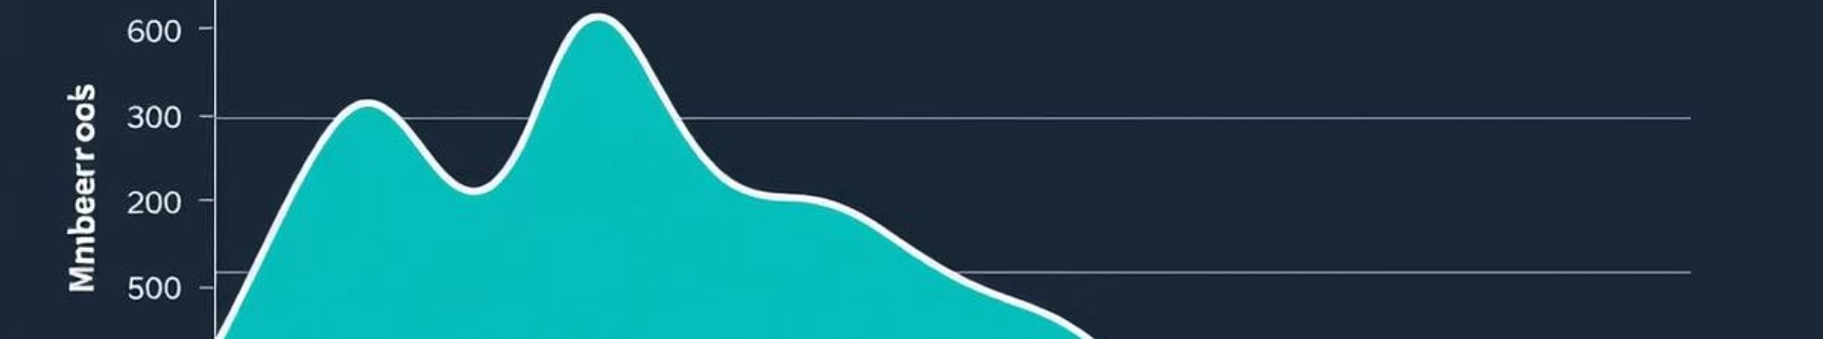
Data Visualization: Temporal Trends
Seasonal Patterns
Events & Holidays
Observe summer vs. winter bookings.
See their impact on pricing and occupancy.
1
2
3
4
Weekly/Daily Trends
Time Series Analysis
Analyze weekend vs. weekday bookings.
Use Pandas and Matplotlib in Python.

Slide 8





Predictive Analytics: Forecasting Occupancy and Pricing
Machine Learning Forecasts
Models predict future demand. Stay ahead of trends.
Occupancy Factors
Seasonality, location, and listing features matter.
Optimal Pricing
Predict best prices. Based on market conditions.
Key Algorithms
Regression, ARIMA, and Prophet models.

Slide 9








Sentiment Analysis: Understanding Guest Reviews
Overall Satisfaction
Measure guest happiness levels.
Improvement Areas
Identify areas needing enhancement.
Keyword Identification
Find positive and negative themes.
NLP Techniques
Analyze reviews using natural language processing.

Slide 10




Case Study: Optimizing Listings in San Francisco
High-Demand Neighborhoods
Analyzed data to find popular areas.
Optimize Listings
Improved descriptions and photos.
Dynamic Pricing
Implemented strategies to boost revenue.
Significant Results
20% occupancy increase. 15% ADR boost.

Slide 11








Conclusion: Data-Driven Success on Airbnb
Key Takeaways
Continuous Adaptation
Benefit both hosts and guests.
Monitor and adjust constantly.
Future Trends
Competitive Edge
AI and personalized experiences.
Leverage data for success.

Slide 12
Thank you

